Slide 1
Salma Tarek Shafik
PD Discussions

Slide 2
Your Best Achievement
I have led the release to production and delivered QA team’s status to our delivery manager.
I have updated the Postman scripts of APIs to be general and changed based on the environment used and shared this with my team and that saves a lot of time.
I have created some steps to execute Office Spaces product’s scenarios with the required links to complete the execution and shared this with my team to save time.
I have worked on Kafka Connector.
I have implemented the base Automation scripts for SolutionHub-UI and share with the team to continue working with it.
I have worked on GitLab to push, merge and pull our automation framework.
I have attended performance training , completed it and made the assignments required.
I have completed 20% of QA track courses on Pluralsight.
I have completed “Learn Selenium WebDriver with Java” course on Oreilly.

Slide 3
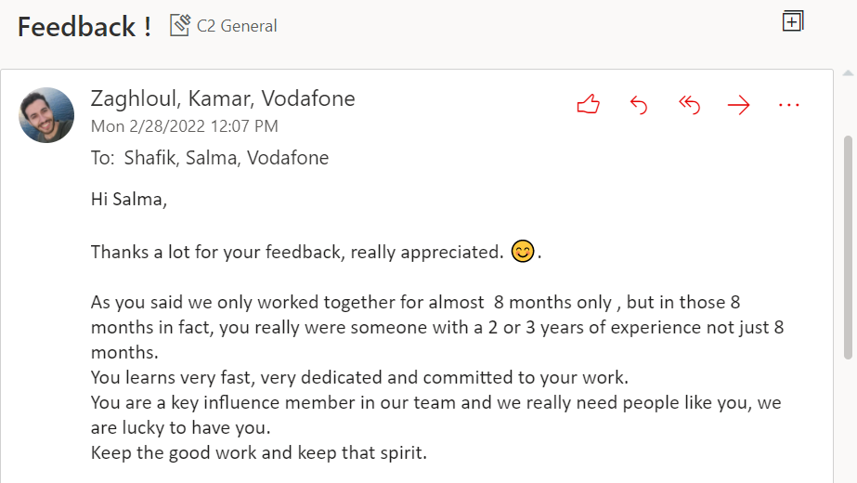
Your Best Achievement
I gave KT to newcomers.
I have recorded some demos to the product owners to help them in the meetings with the customer.
As a team , we have got thankyou and appreciation mails from the customer and product owner.

Slide 4
Your Goal and Vision for Next Fiscal Year
Complete Pluralsight courses.
Improve my knowledge in Mobile Automation.
Take SAFE Agile course and try to take the certificate.
Improve my knowledge in Jenkins CI and Git Version Control.
Learn more about Devops for QA Tester.
Help me to practice these skills in different projects.

Slide 5
Manager Feedback (this is Feedback on Mona Galal to be filled by you)
Always trying to set the weekly meeting and providing us with important news.
Also trying to help and support us.
What he need improvements

